Slide 1
Skin Disease Diagnosis on Darker Skin
By: Reagan Esteves, Jamie Hartman, Charles Tyndal, and Chenyu Zhao
Faculty Mentors: Dr. Zhengming Ding and Dr. Jihun Hamm

Slide 2


Slide 3
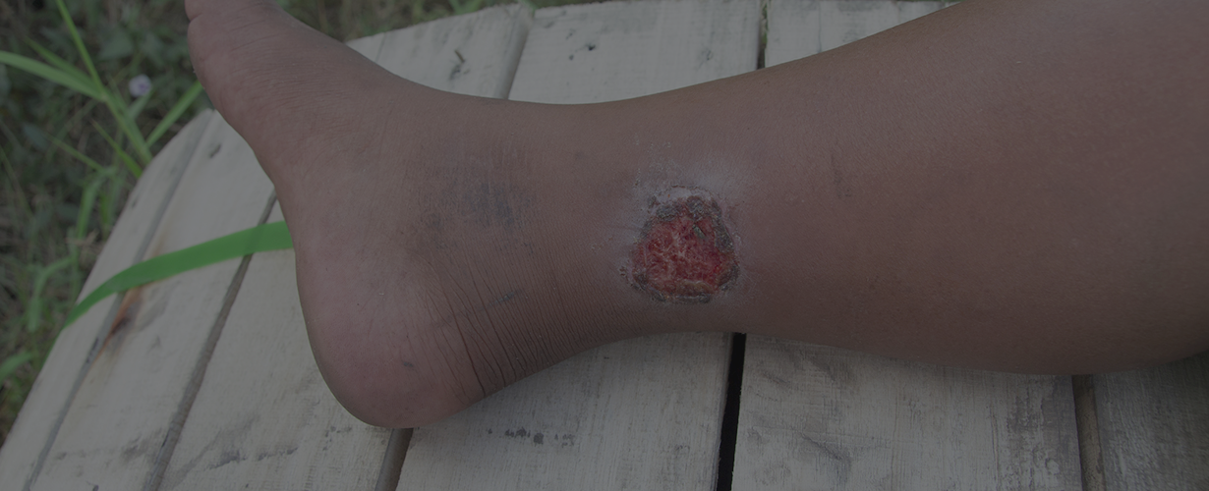
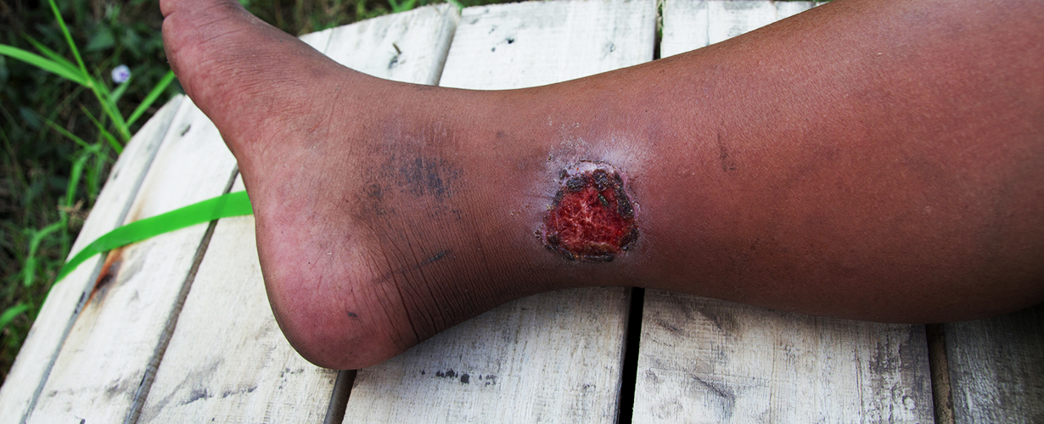
Problem
Diagnosing skin disease is expensive (sub saharan Africa)
Currently, only dermatologists diagnose skin diseases
Issue: time consuming and expensive for patients
Many patients cannot afford the time and expenses
Application:
Mr. A has a Buruli ulcer
Can’t meet expense and time for appointment and treatment
Solution: take a photo of the problem -> upload into our Application (Picture A)
Application crops and enhance the image (Picture B)
Gives diagnosis: Buruli Ulcer, and the confidence level 95%
Give estimate of the recovery status aka 20% recovered
Picture A
Picture B

Slide 4
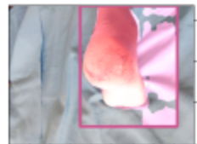
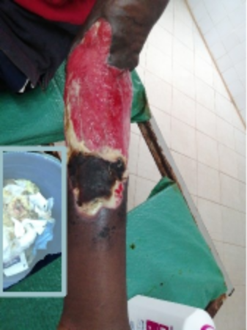
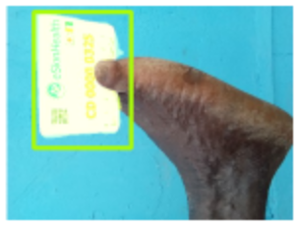
Goals & Challenges
Identifying body part using object detection
2. Getting correct mask based on the bounding boxes
3. Increasing accuracy of object detection
Challenges:
Ensuring the bounding box is on the body part instead of other objects
Noisy Backgrounds
Multiple Body Parts
Challenges:
Masking patches in bounding boxes
Keeping masking inside bounding box region
Challenges:
Body parts holding objects
Image distortion (angle and overexposure)

Slide 5
Overview Of Proposed Approach
Overall application: allow potential user to take a photo of their skin disease and identify potential disease
1st step: analyzing the image and determining the region of interest (ROI)
Filtering, Masking
2nd step: enhancing cropped image with techniques
super-resolution, color correction
3rd step: disease diagnosis
Domain adaptation, Augmentation techniques
outputs the disease and the confidence level
4th step: Interpretation
Uses deep learning and visual patterns
Output: potential recovery status of the patient

Slide 6
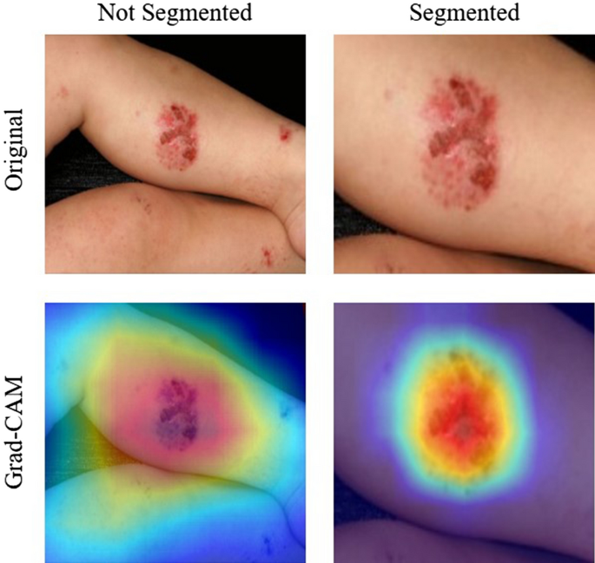
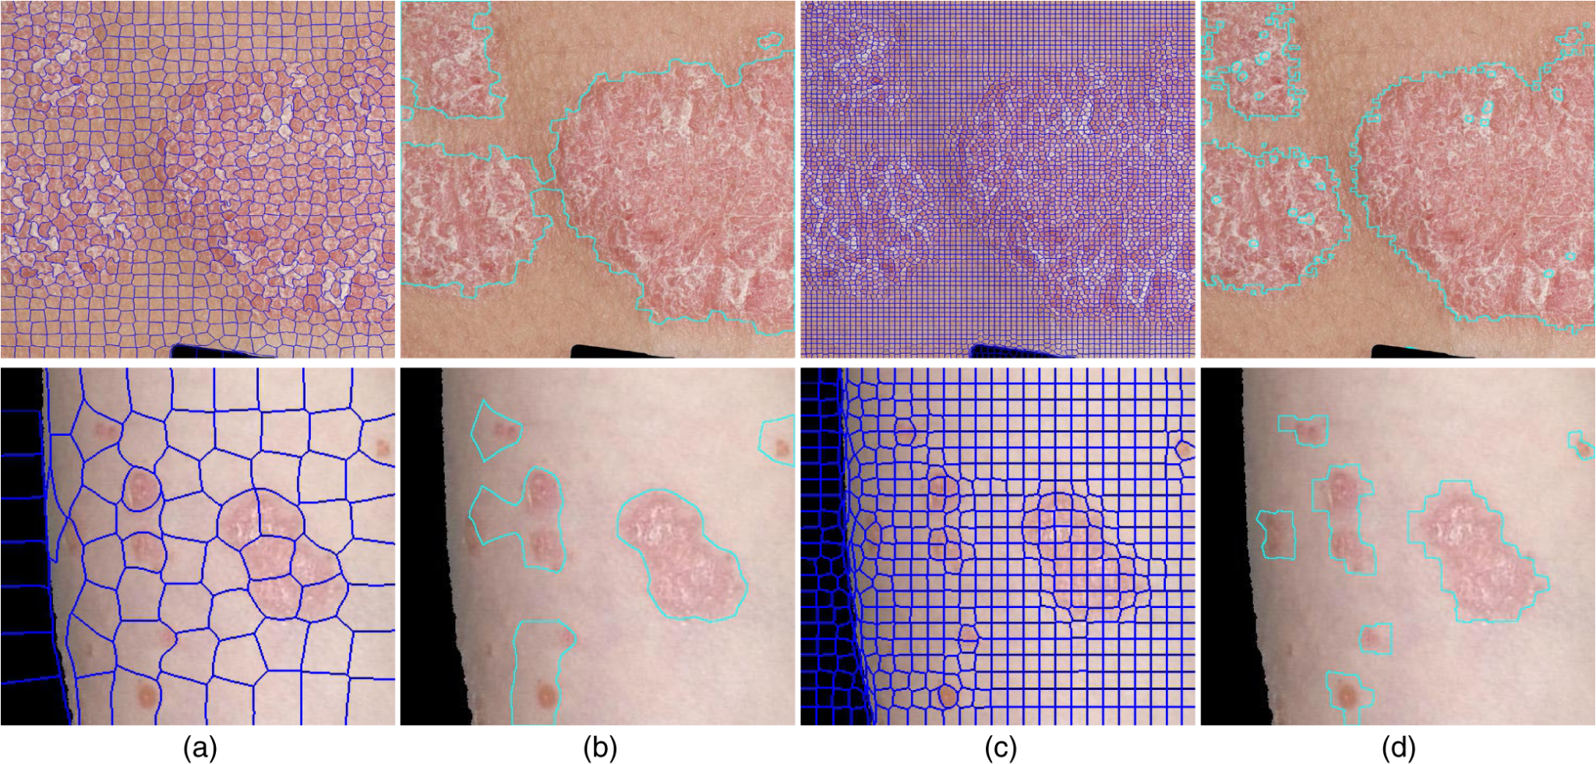
Similar Works
Many other skin disease detection systems are out there, though many required refined images of lighter skin tones.
The major difficulty these pieces of software are struggling with is getting accurate results over many diseases that appear very similar visually, but differ greatly beneath the surface.
[1][2]

Slide 7
Work Conducted so Far
Prototype code (ROI detection and masking)
Filtering before ROI detection
Clustering of super pixels/Contours

Slide 8
Prototype Code and new Attempts
Prototype:
For object detection and segmentation using masking
Used Pytorch (ML) to build the models needed for the code
Attempt 1:
Building upon prototype 1, we tried to filter beforehand so that the mask can apply with better results
Attempt 2:
Also built upon prototype 1
Separate clusters of pixels to isolate disease
Additionally, using contour detection to map out which areas have the most differences compared to the rest (normal skin vs diseased skin)

Slide 9
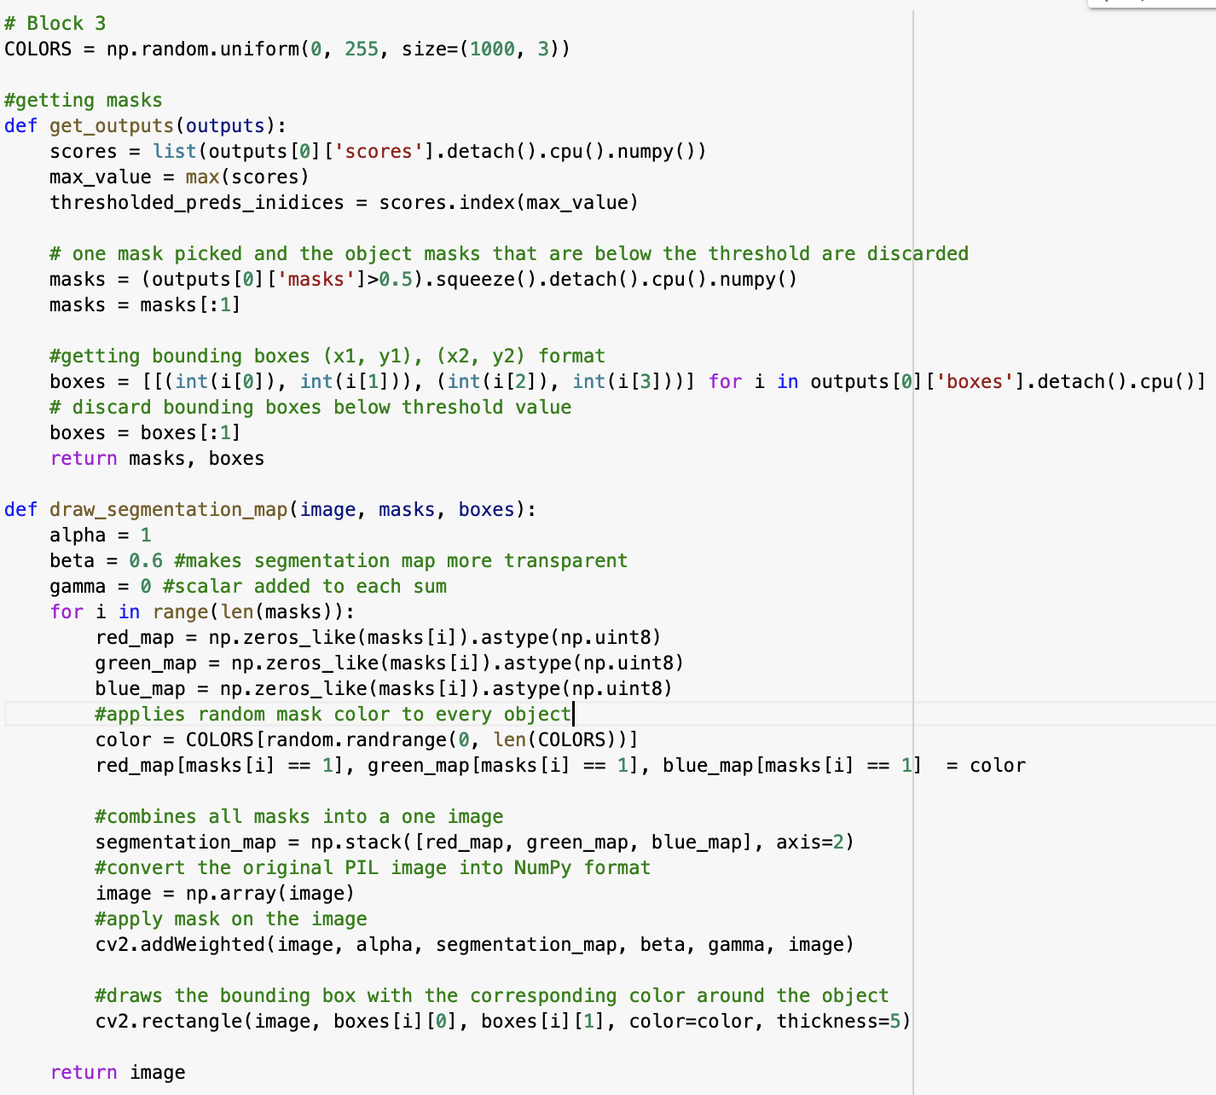
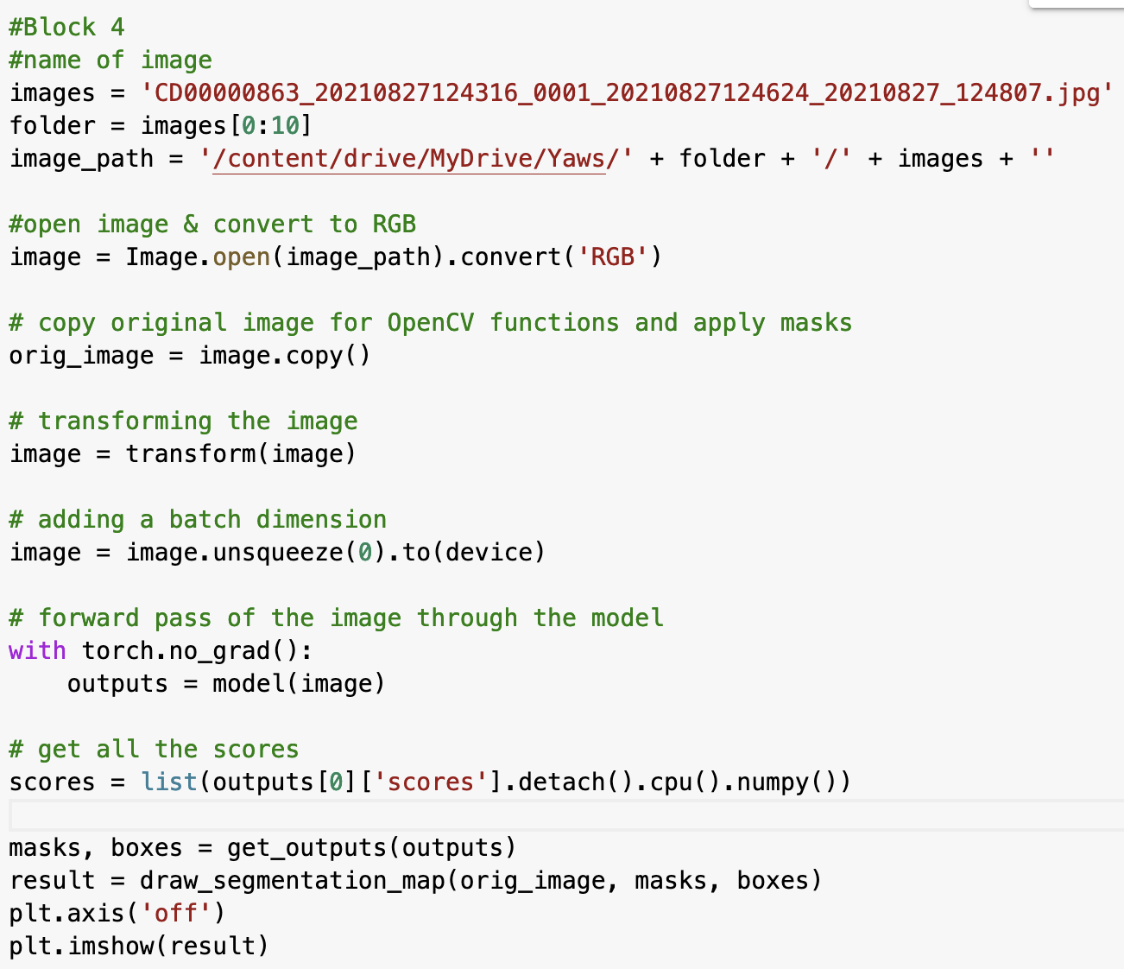
Prototype Code 1 Explanation
Block 1 : import drive & libraries
Block 2 : initializes the model using torchvision, sets up the computation device (cuda), and uses transform to convert the image to tensor.
Runs segmentation & bounding boxes through the images, image result then displayed
Getting the bounding boxes and drawing the segmentation
Notes:
Block 1 : import drive & libraries
PIL - enables Python for working on images, torch for tensors, torchvision - image transforms in computer vision
Block 2 : initializes the model using torchvision, sets up the computation device (cuda), and uses transform to convert the image to tensor.

Slide 10
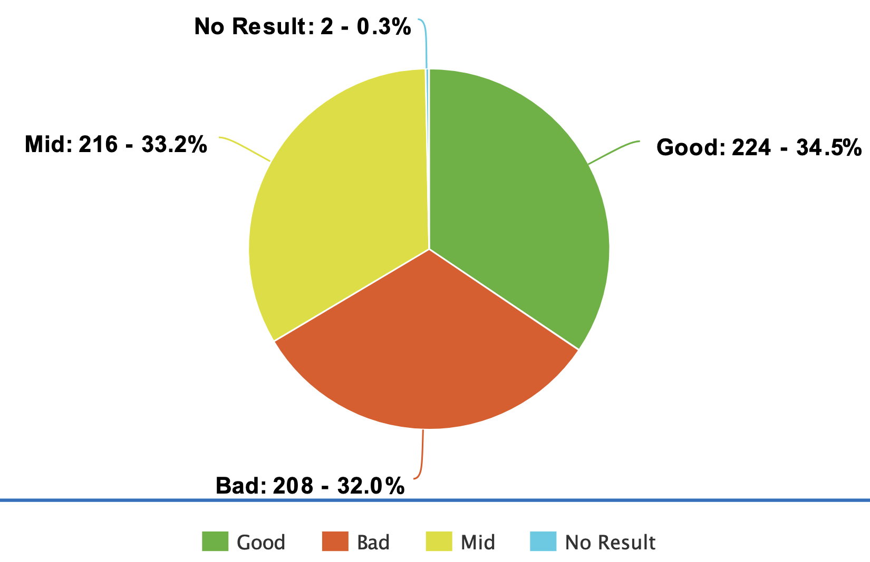
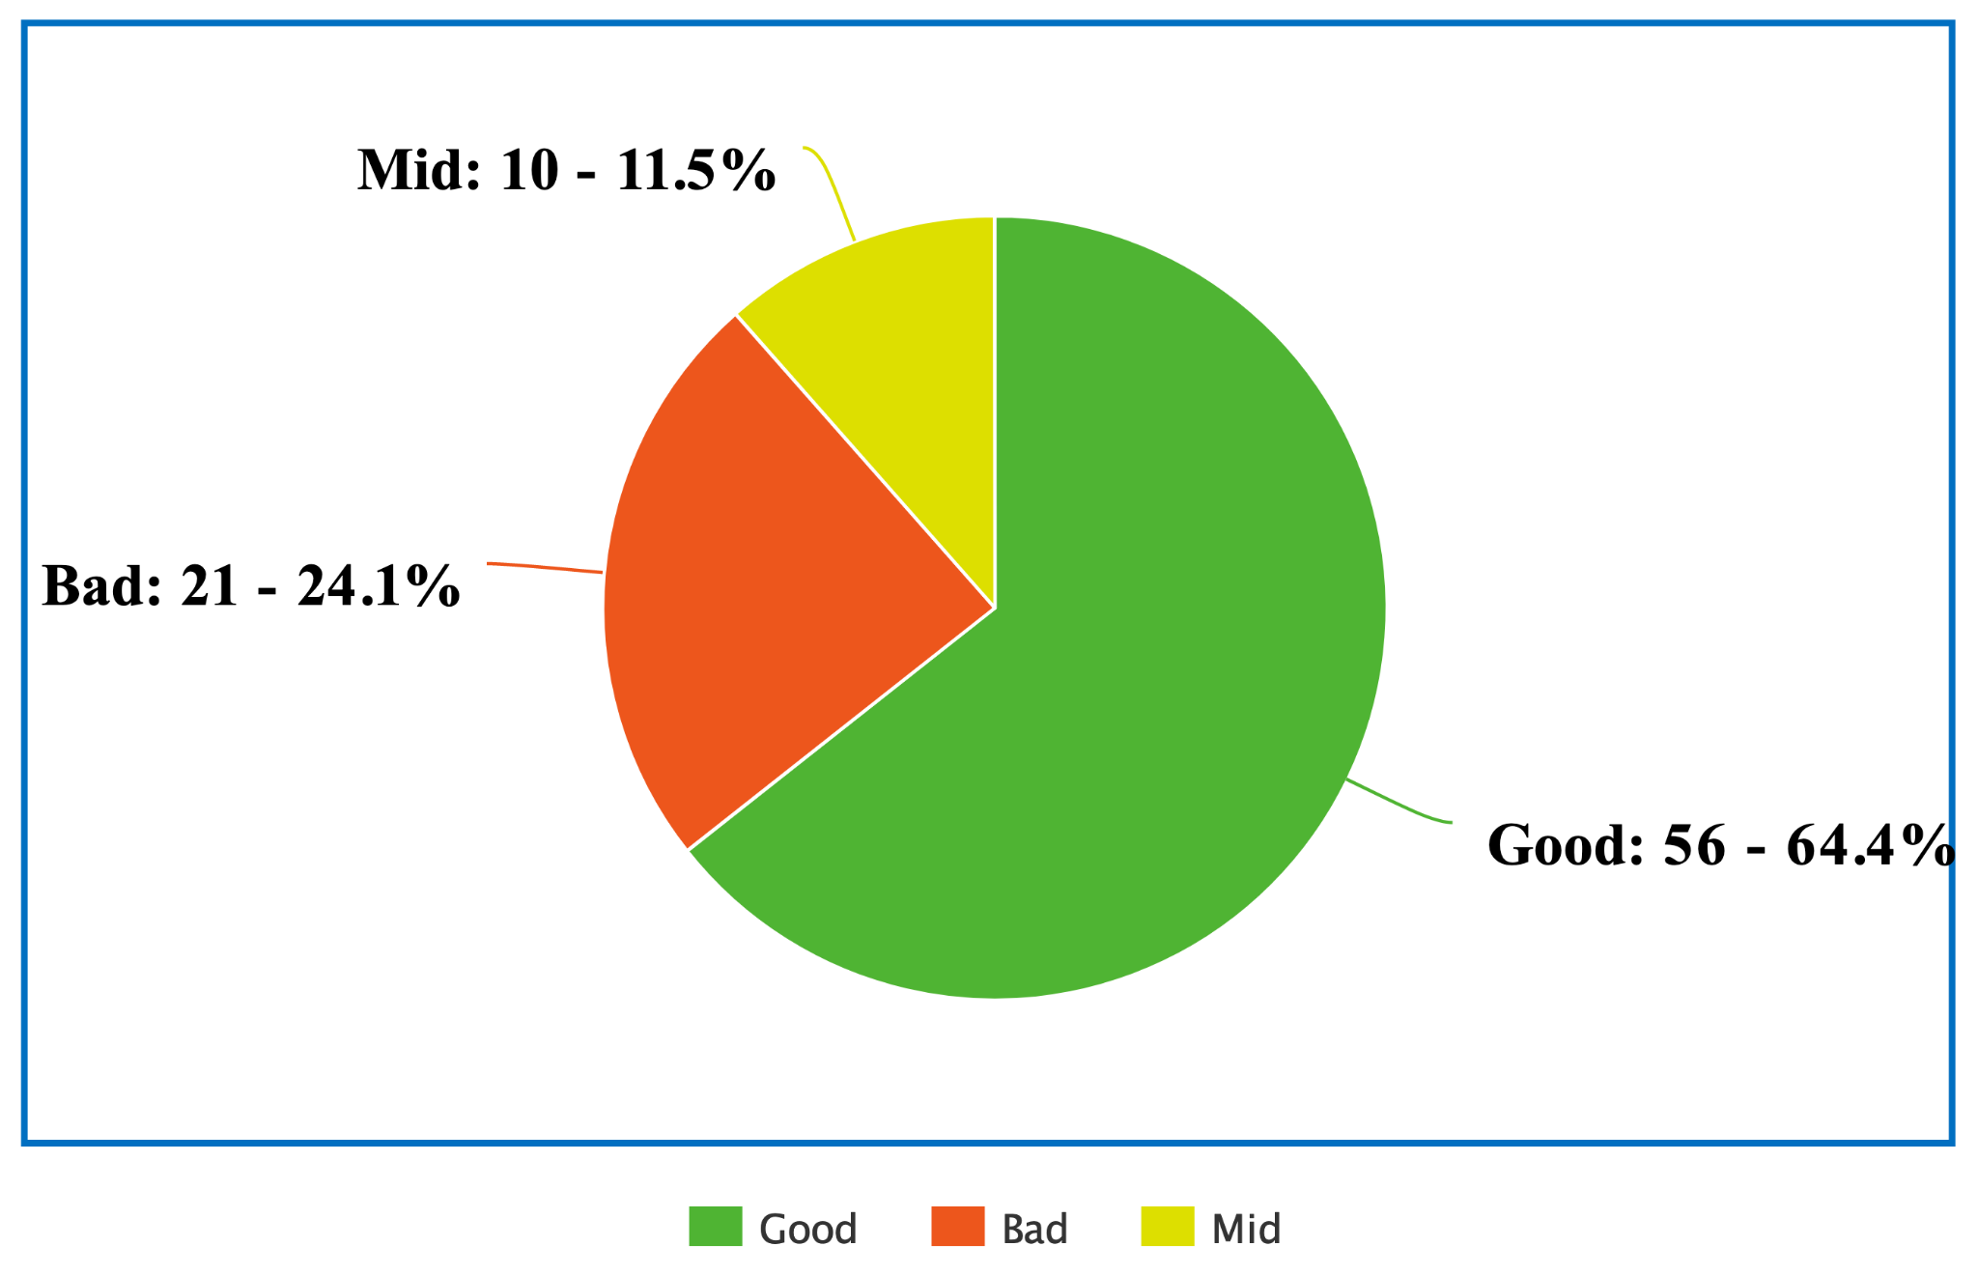
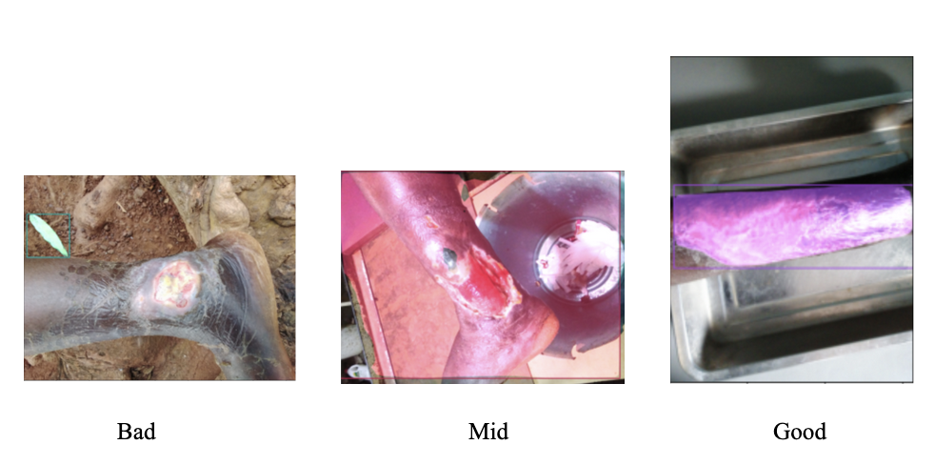
Pie chart/Results
Good = bounding box on body part
Mid = bounding box on body part and background
Bad = bounding box not on body part
Buruli Ulcer
Yaws
Notes:
Mention tasks, we each did like 200 pictures and crossed referenced with the group to ensure we agree on the ratings

Slide 11
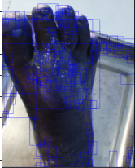
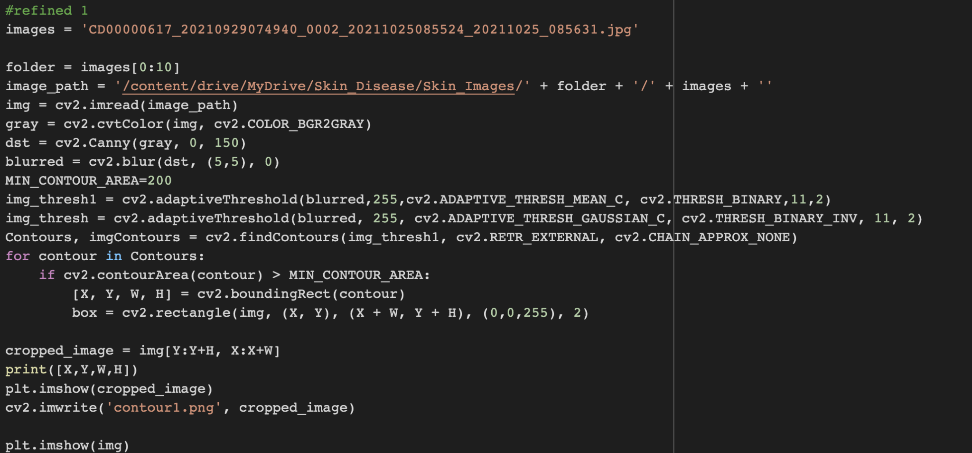
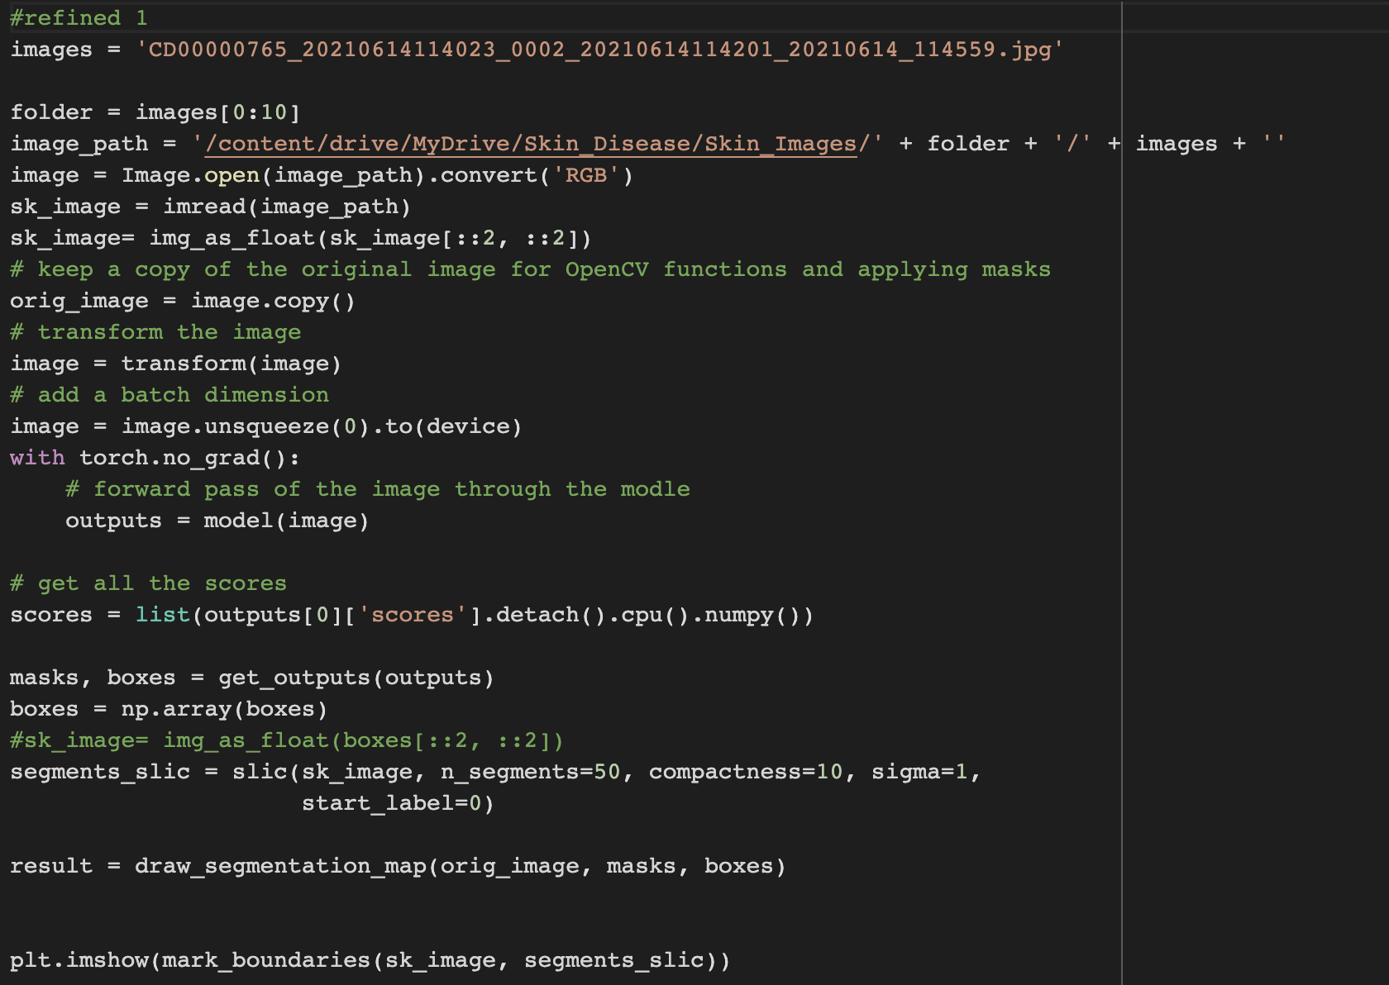
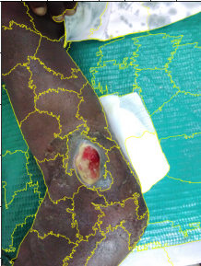
New Attempts and How work was spilt
For this project, we all worked together on the prototype. We split judging the results evenly in a google sheet (Buruli Ulcer, Yaws, and Leprosy). Then we checked each others grading and changed if necessary. Afterwards, we began working on new codes that build off of the prototype. Current attempts were done by Chenyu and Reagan
Contours
Super Pixels
[3][4]

Slide 12
Remaining Work
Implementation
With the pre-processing of images with Super pixels and contouring, these systems need to be then connected directly to the ROI detection we are currently using.
Run all images with the pre-processing and ROI and compare results to those without pre-processing.
Testing Detection on Other Skin Diseases
Run tests on the remaining images on our dataset with our preexisting ROI code to get the baseline results for the entire dataset.

Slide 13
Works Cited & Our Work so far
1] Li-sheng Wei, Quan Gan, Tao Ji, 2018. "Skin Disease Recognition Method Based on Image Color and Texture Features", Computational and Mathematical Methods in Medicine, Retrieved from https://doi.org/10.1155/2018/8145713.
[2] Topiwala Anirudh, Al-Zogbi Lidia, and Fleiter Thorsten, Krieger Axel 2019. “Adaptation and Evaluation of Deep Learning Techniques for Skin Segmentation on Novel Abdominal Dataset”, In 2019 IEEE 19th International Conference on Bioinformatics and Bioengineering (BIBE),p. 752--759, IEEE.
[3] Darshita, Jain. 2020. Superpixels and Slic. (April 2020). Retrieved October 2, 2022 from
https://darshita1405.medium.com/superpixels-and-slic-6b2d8a6e4f08
[4] Yasmeen M. George, Mohammad Aldeen, Rahil Garnavi, "Automatic psoriasis lesion segmentation in two-dimensional skin images using multiscale superpixel clustering," J. Med. Imag. 4(4) 044004 (10 November 2017) https://doi.org/10.1117/1.JMI.4.4.044004
https://drive.google.com/drive/folders/1rpBsAFPqcA59arrNLMuPNAczhmAWk4xK?usp=sharing

